Slide 1


Slide 2
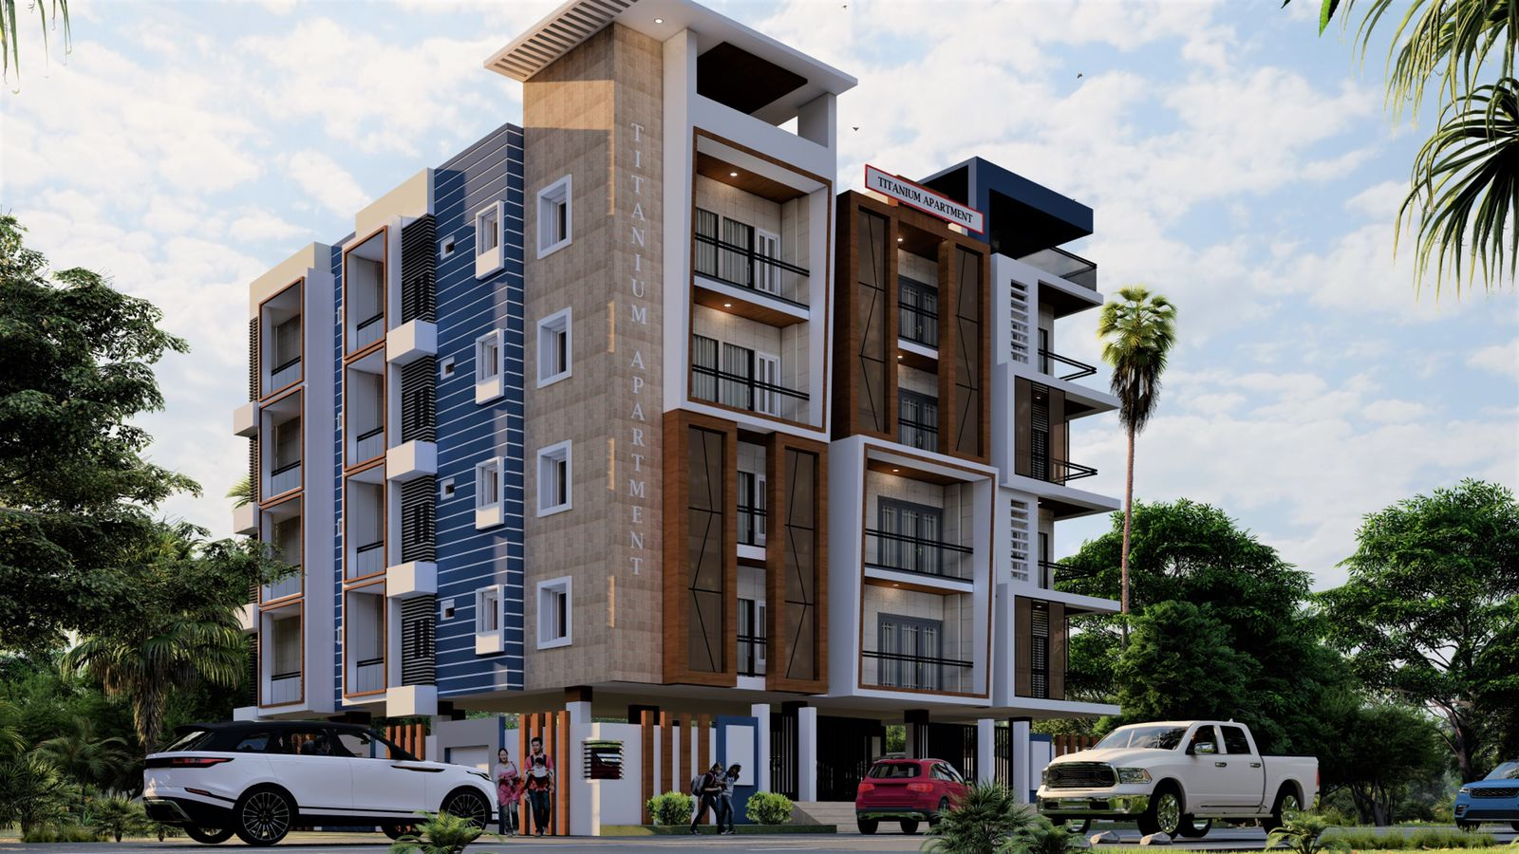
G.S. RESIDENCY

Slide 3
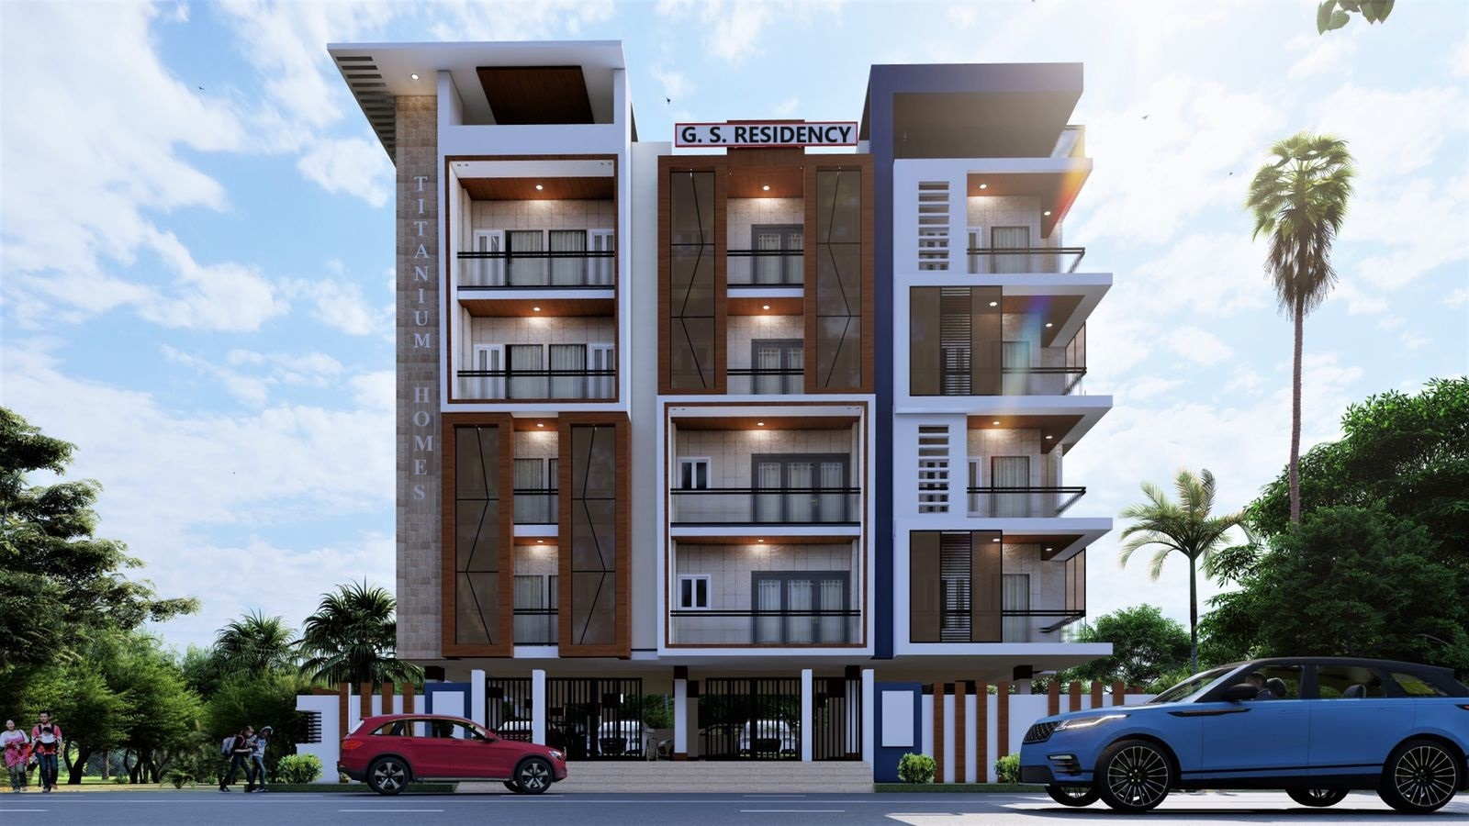
Front View

Slide 4
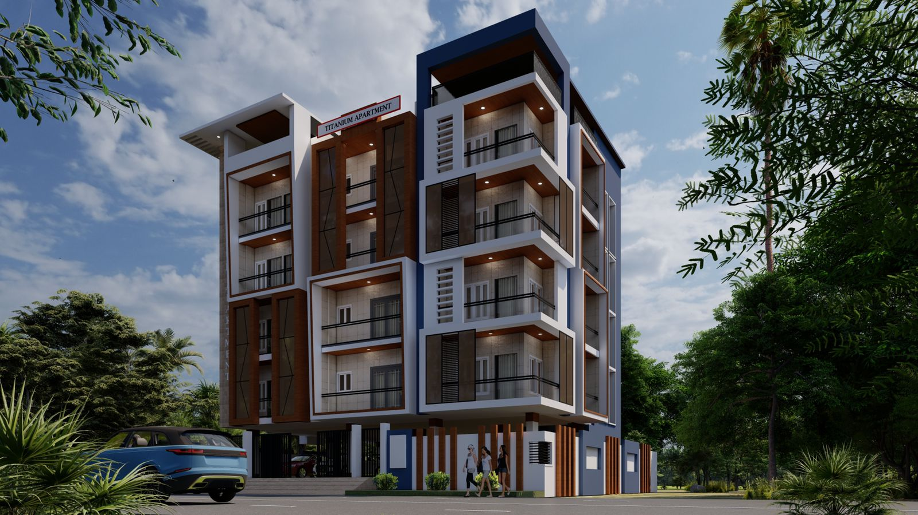
Side View

Slide 5
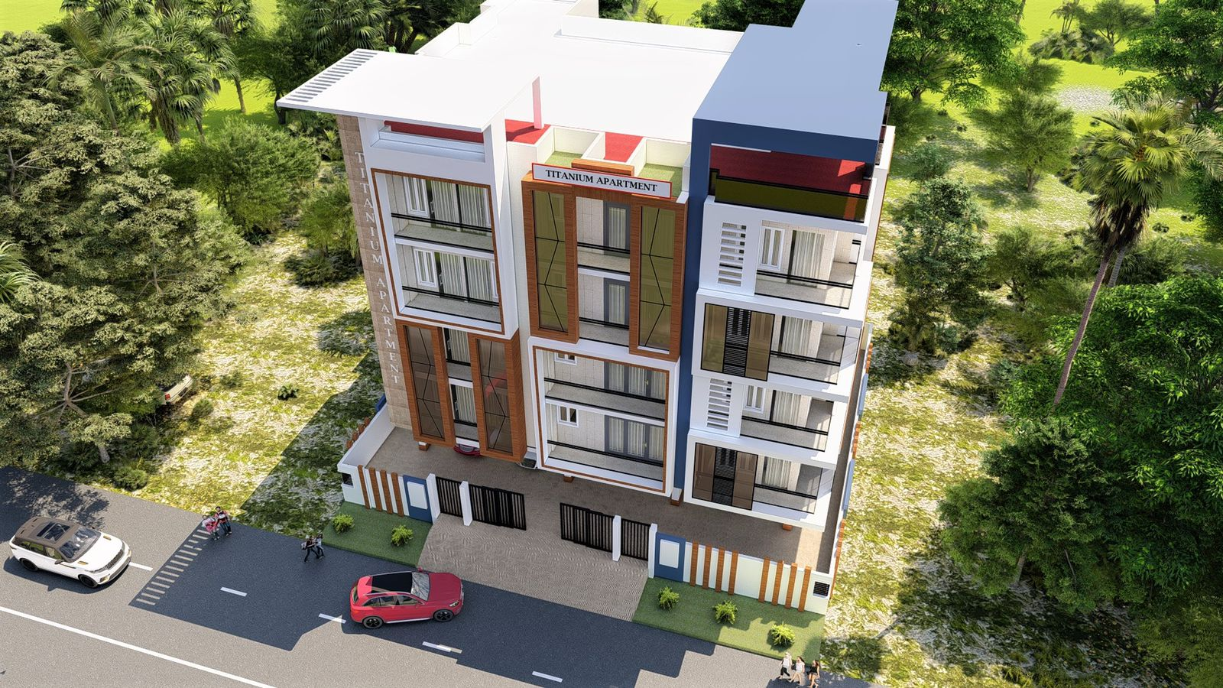
Top View

Slide 6
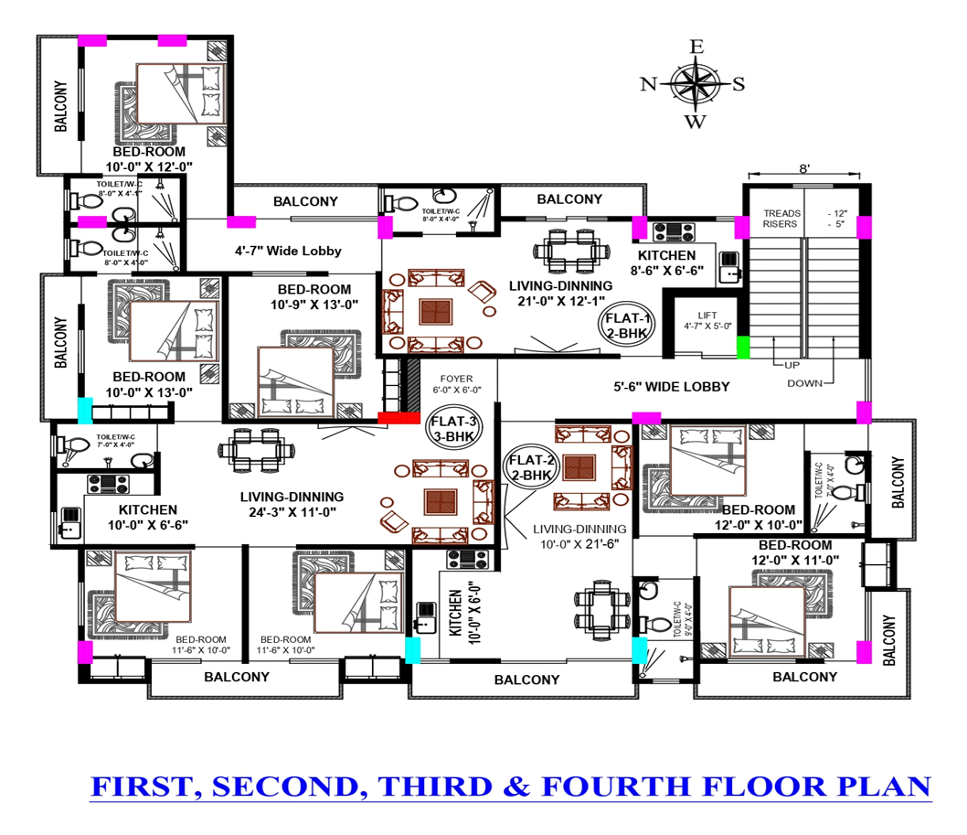

Slide 7
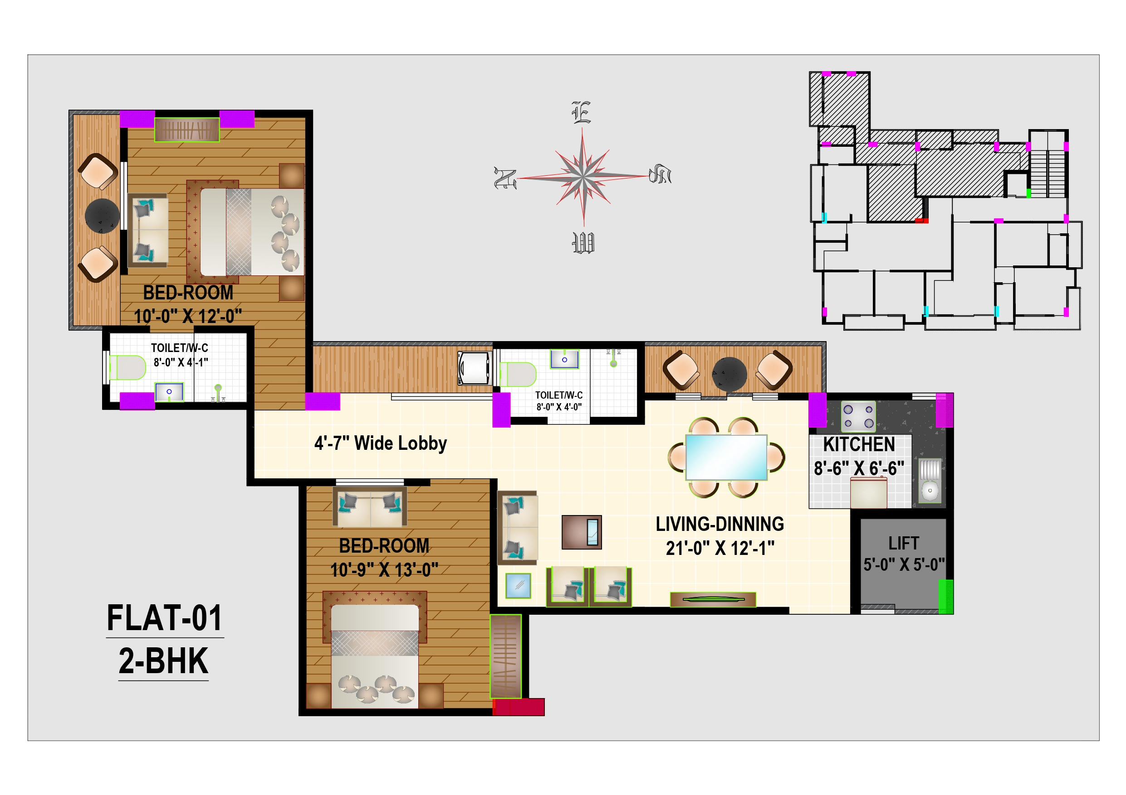
TYPE | 2BHK
FLAT Number | 01
Salable Area | 1216
Built-up Area | 1060
Carpet Area | 811
2BHK – Type-A

Slide 8
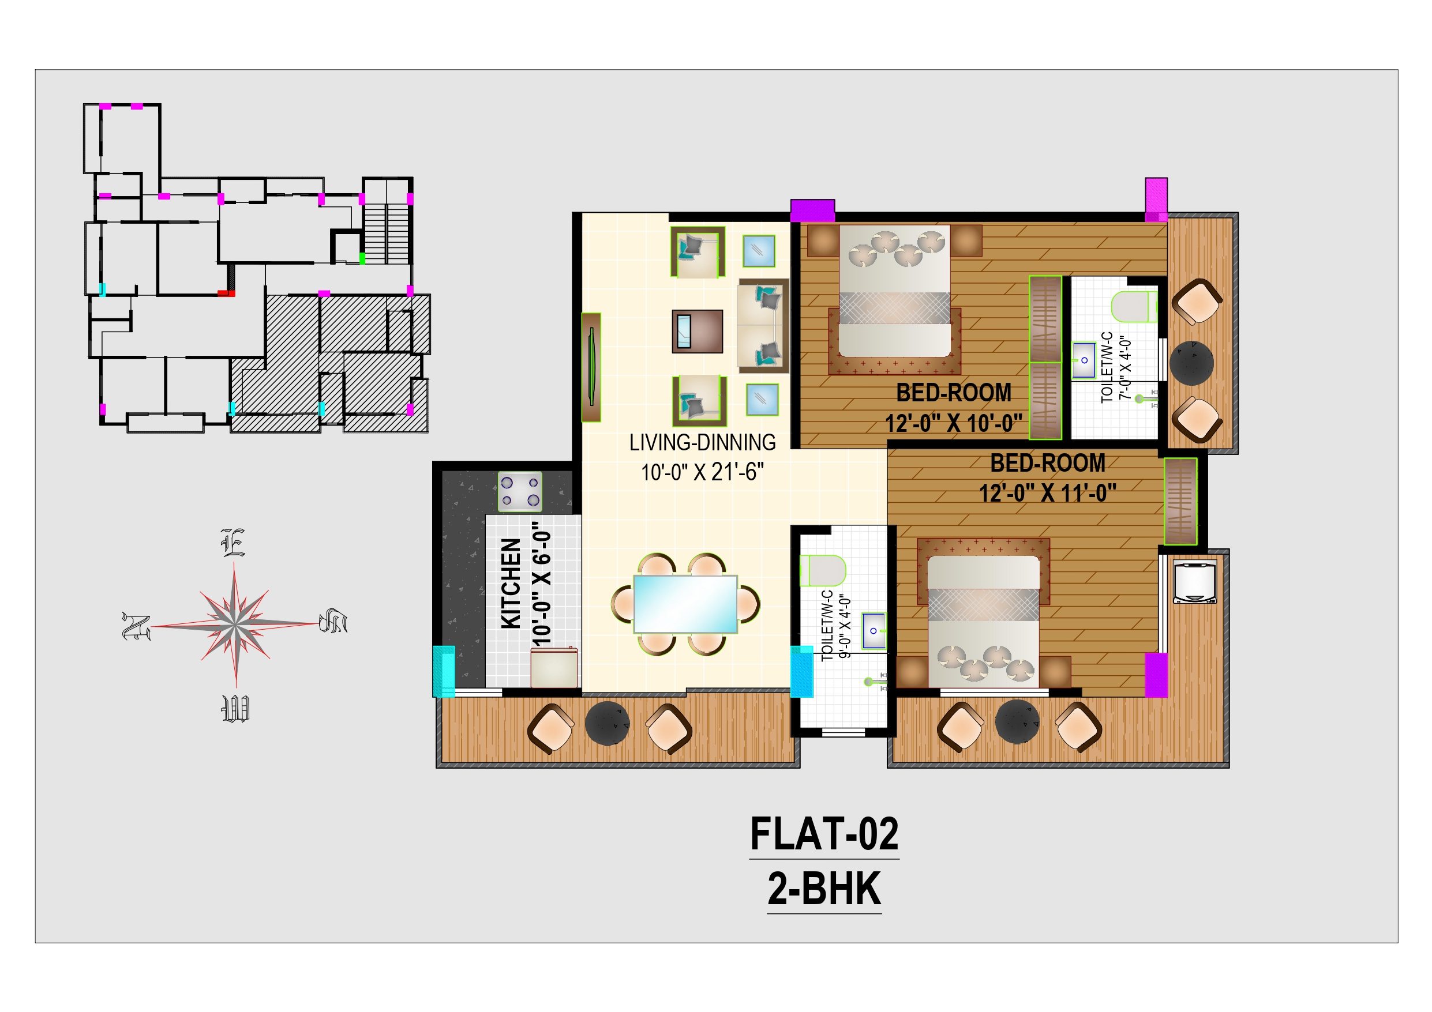
TYPE | 2BHK
FLAT Number | 02
Salable Area | 1207
Built-up Area | 1050
Carpet Area | 805
2BHK – Type-B

Slide 9
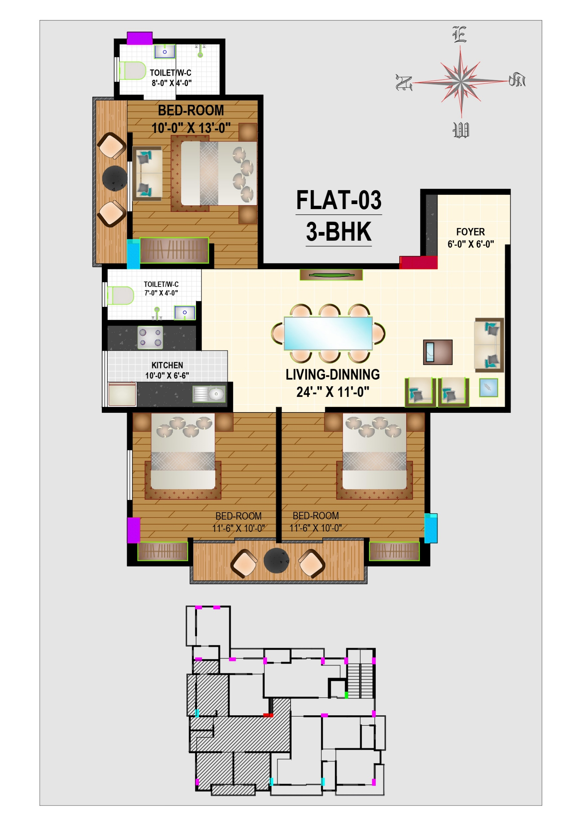
TYPE | 3BHK
FLAT Number | 03
Salable Area | 1450
Built-up Area | 1100
Carpet Area | 967
3BHK

Slide 10
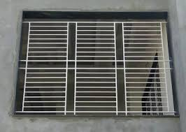

ATTRACTION FOR FLAT/APARTMENT
Iron Grill in windows
Fals Celling with Lights (Bed Rooms & Hall)

Slide 11
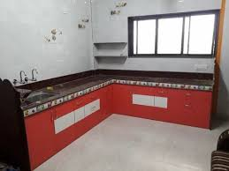
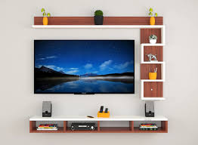
Modular Kitchen
(without upper cabinet)
TV Unit in Hall

Slide 12

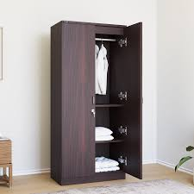
Wall Painting Colours (As per Your Choice)
Wardrobes in Bed Room

Slide 13
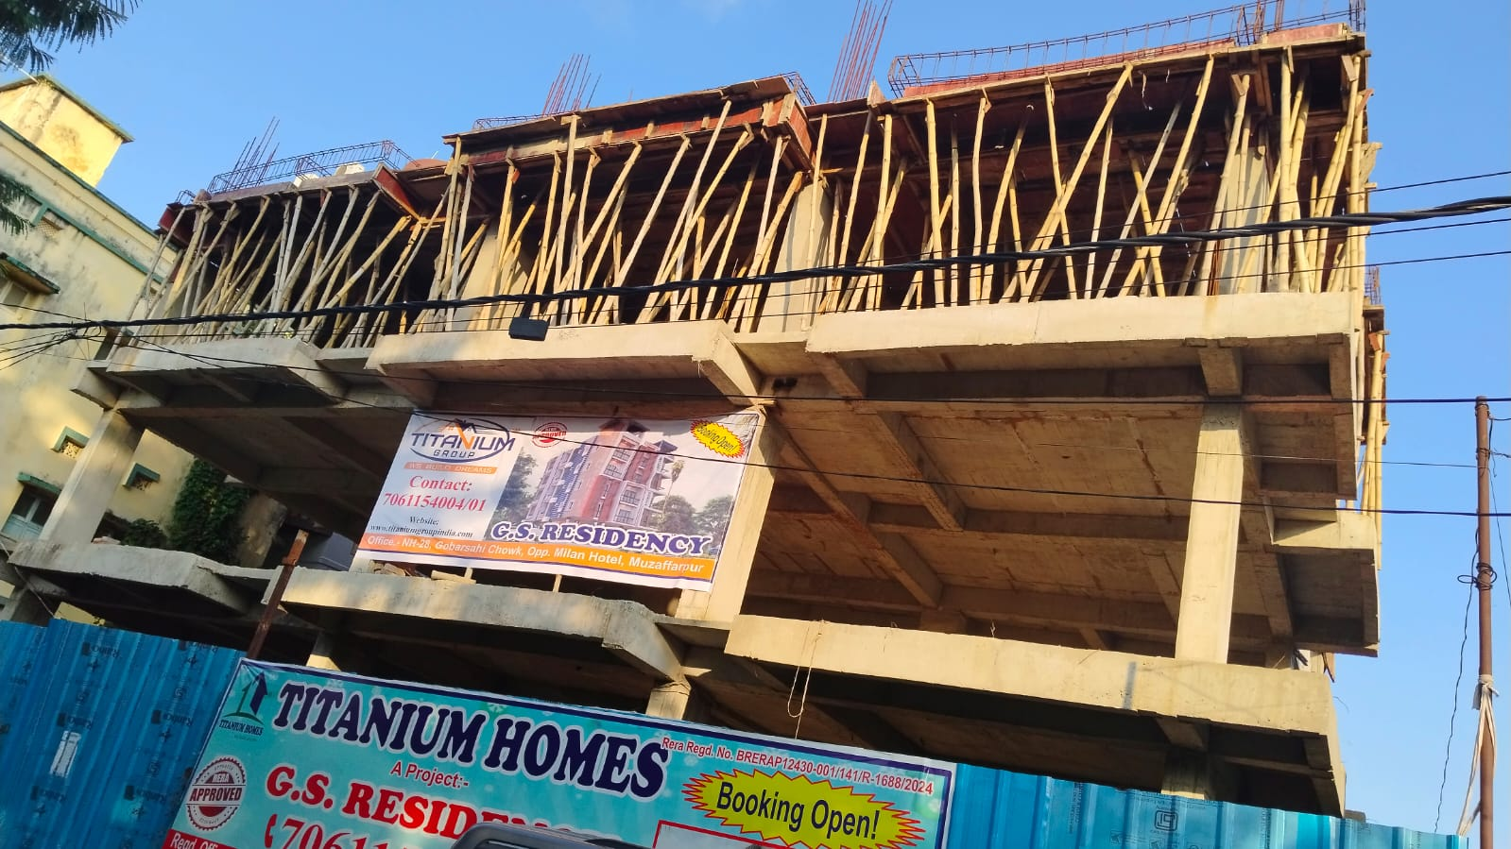
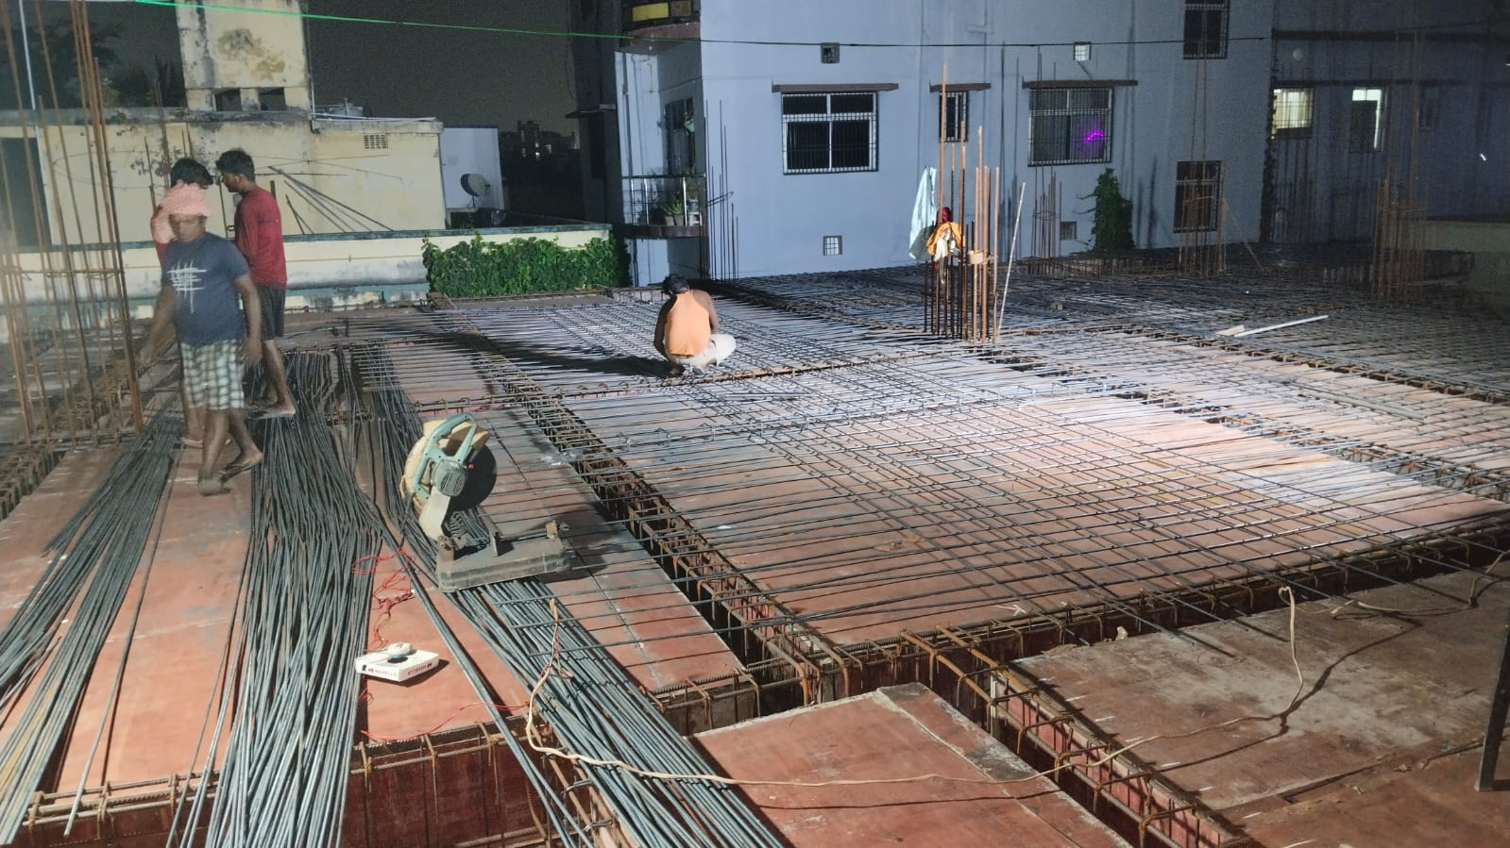
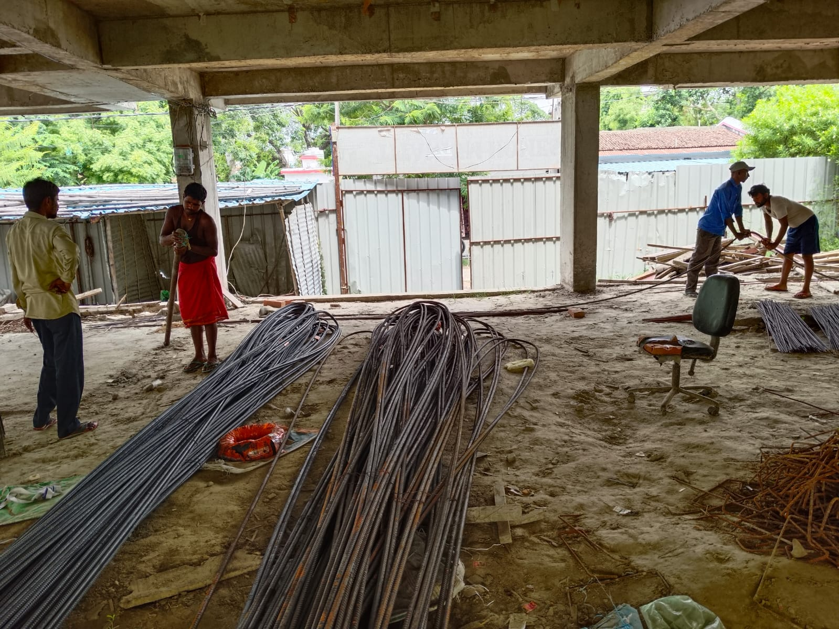
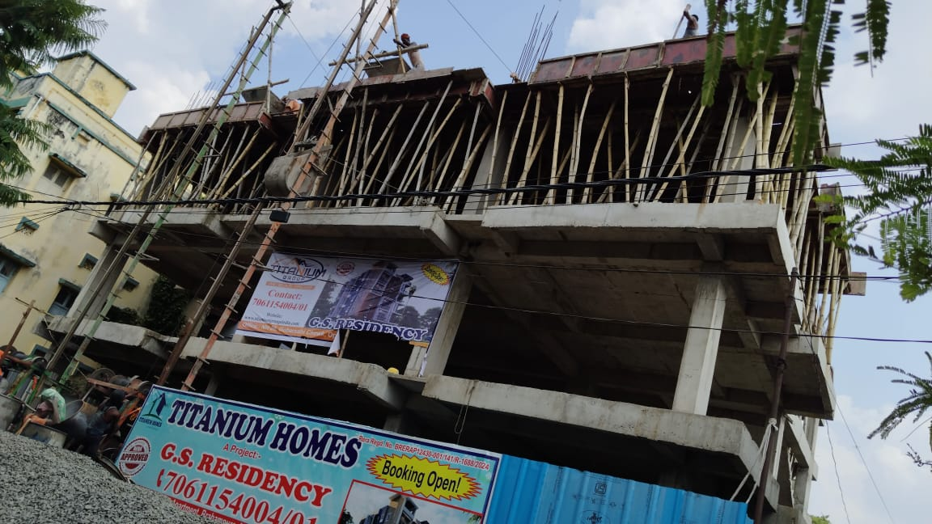
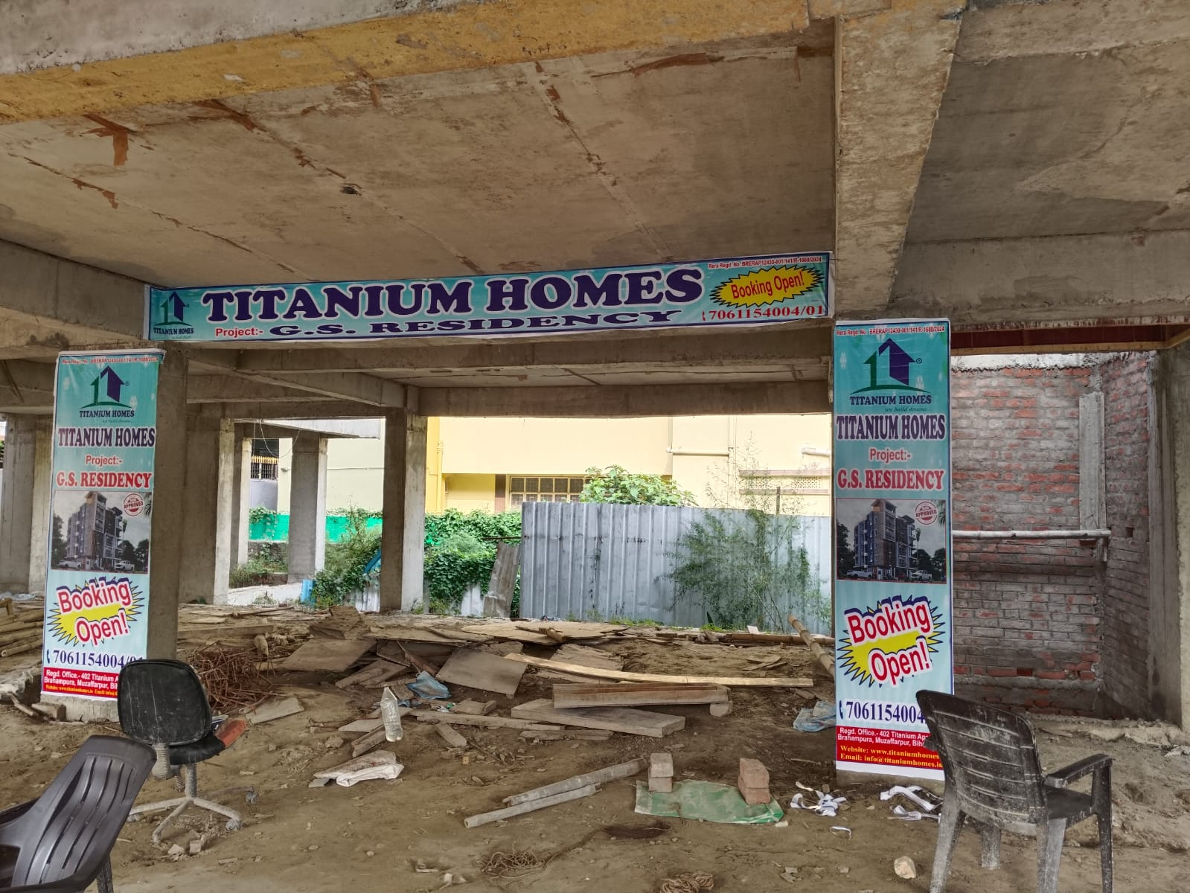
Work in Progress…

Slide 14
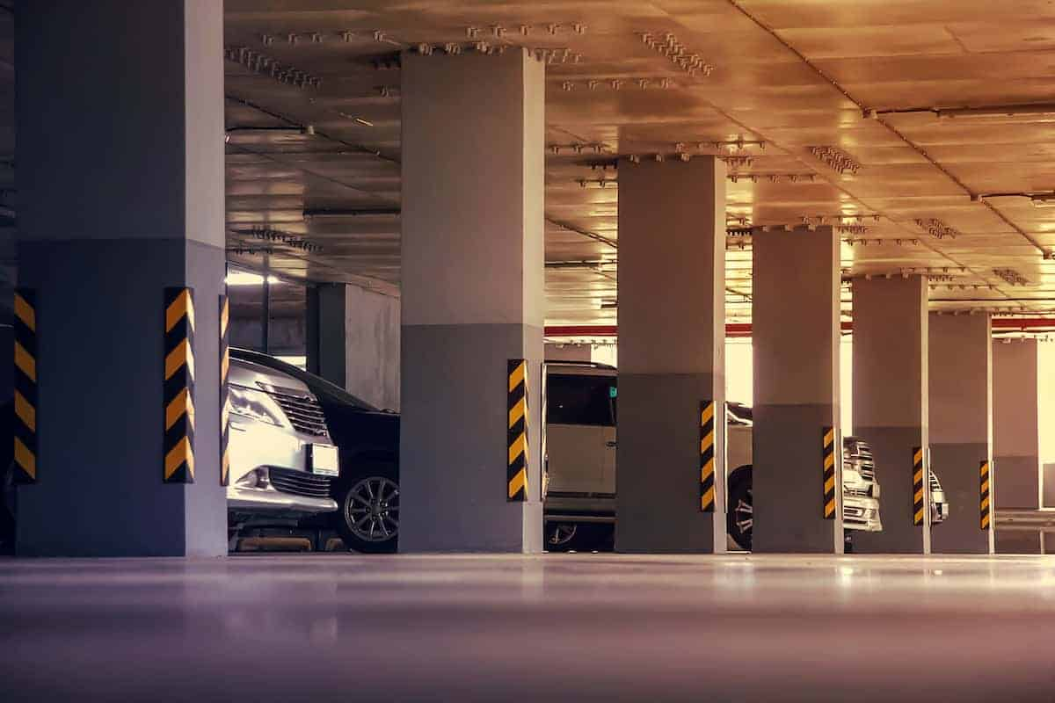
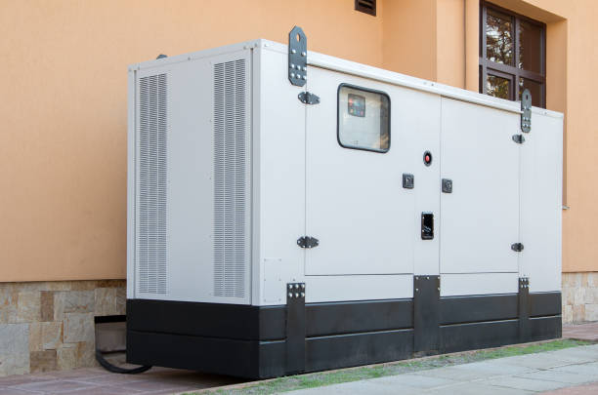

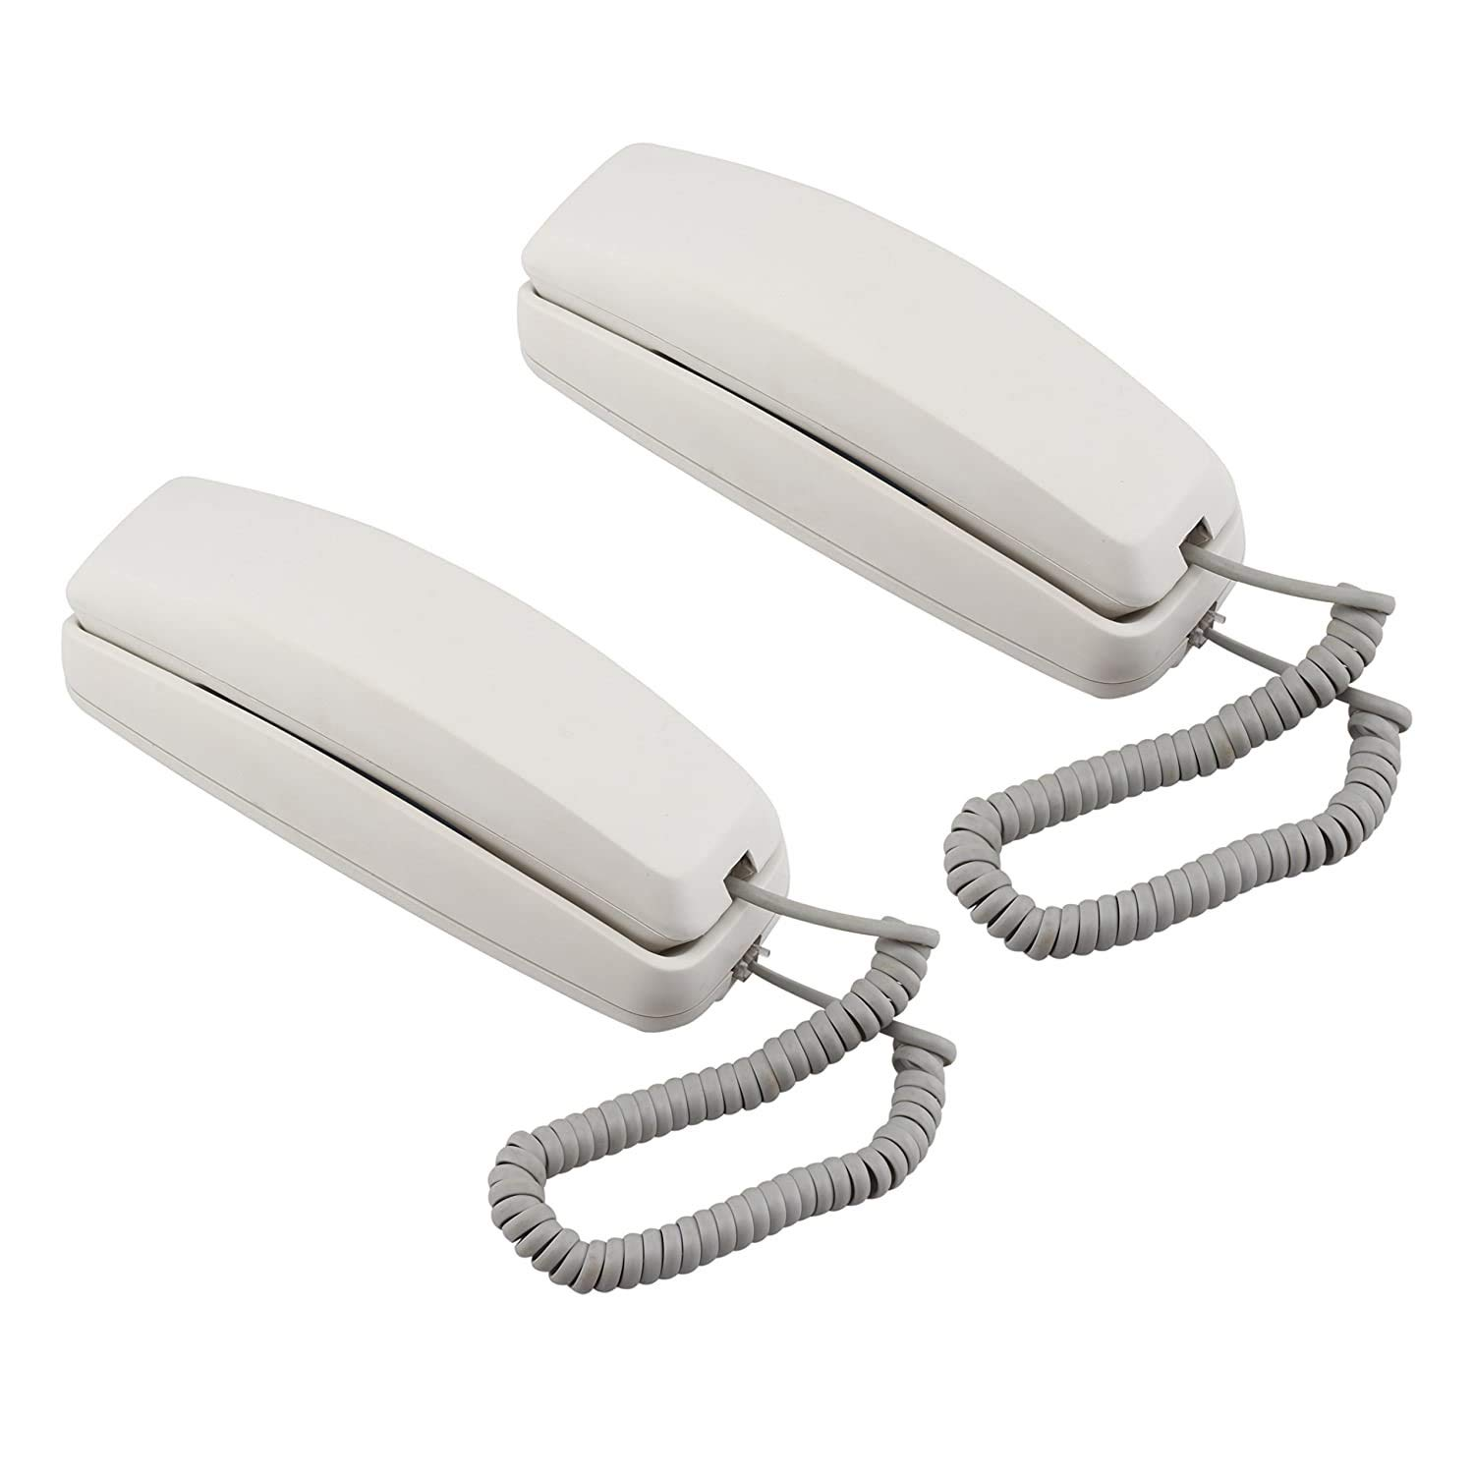
Special Attraction for Building
Lift
CCTv Surveillance
Covered Parking
Power Backup
Water pump
Wi-fi
Intercom

Slide 15
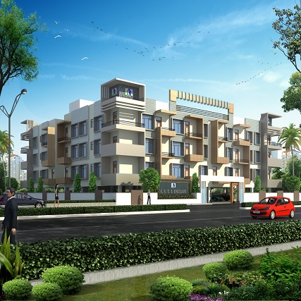
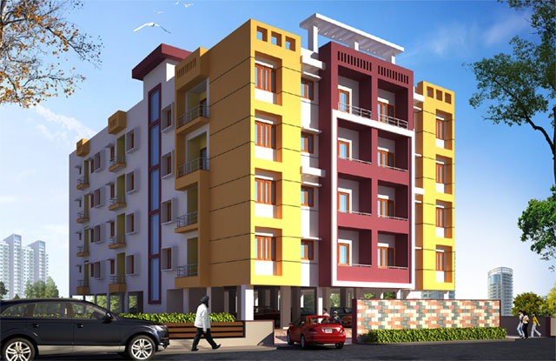
Our Successfully Completed & Handed Over Projects:-
Titanium Apartment
Abhishek Apartment

Slide 16
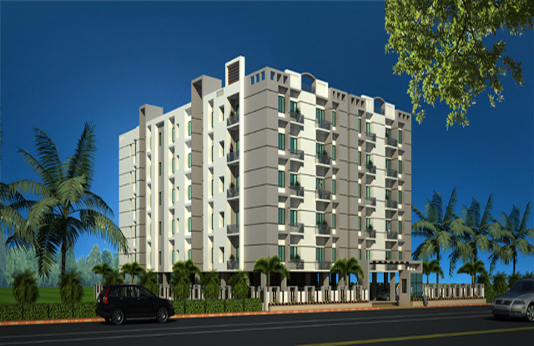
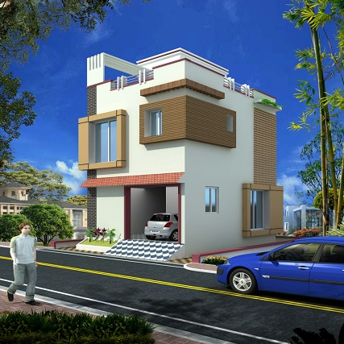
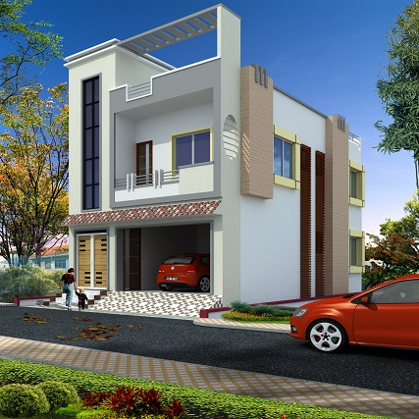
Our Successfully Completed & Handed Over Projects:-
R.P. Complex
Girija Society

Slide 17

CONTACT DETAILS
CORPORATE OFFICE:
MAHARASTRA (MUMBAI) :- Bhiwandi, Maharastra, India, Pin – 421302
BRANCH OFFICE:
MUZAFFARPUR - Gobarsahi Chowk, Muzaffarpur, Bihar, India, Pin – 842001
MOTIHARI - Ambika Nagar, Motihari, East Champaran, Bihar, India, Pin – 845401
Website: www.titaniumgroupindia.com
Mobile: +91-706-115-4004 / 706-115-4001

Slide 18
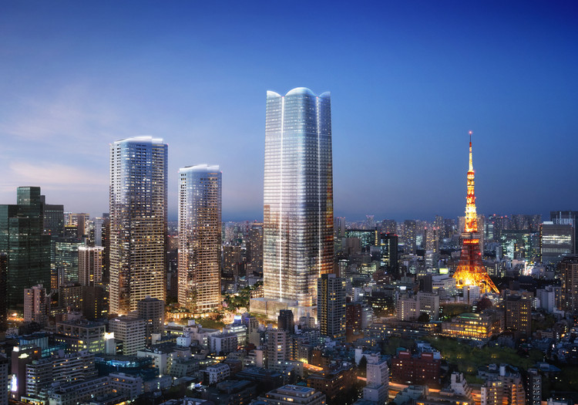
Thank You

