Slide 1


Slide 2
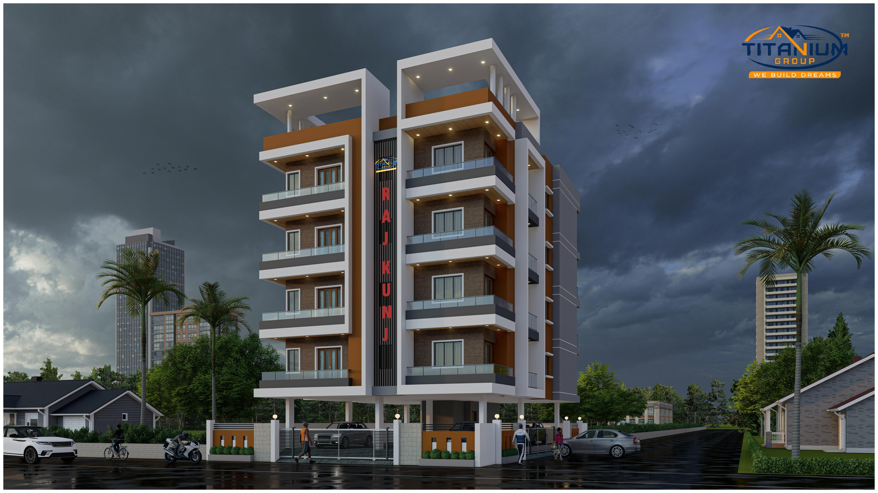

Slide 3
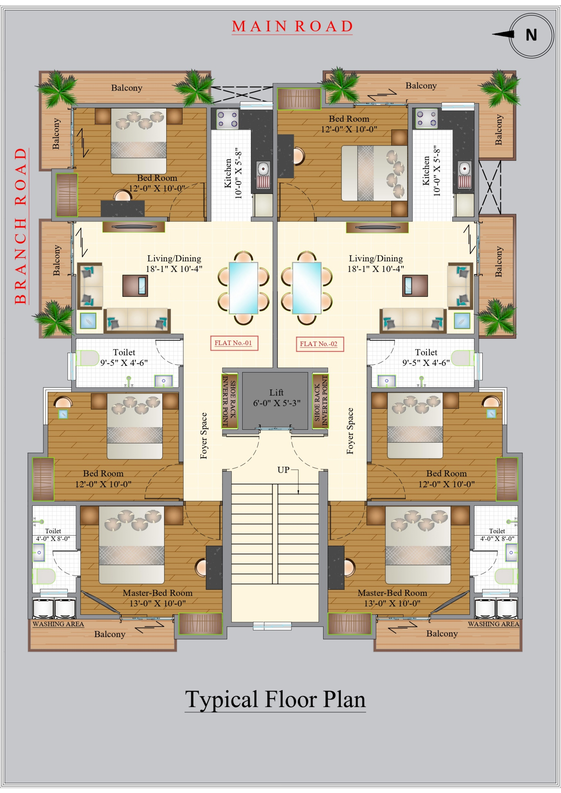
F L O O R P L A N

Slide 4
TYPE | 3BHK
FLAT Number | 01 & 02
Salable Area | 1450 Square Feet
Carpet Area | 950 Square Feet
DISCRIPTIONS
Bed Room | 03
Hall | 01
Kitchen | 01
Toilet | 02
Balcony | 03

Slide 5
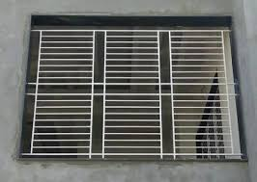
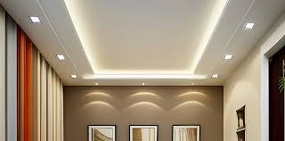
ATTRACTION FOR LUXURY APARTMENT
Iron Grill in windows
Fals Celling with Lights (Bed Rooms & Hall)

Slide 6
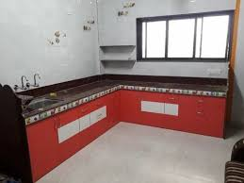
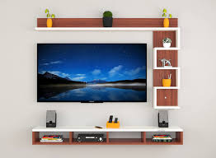
Modular Kitchen
(without upper cabinet)
TV Unit in Hall

Slide 7
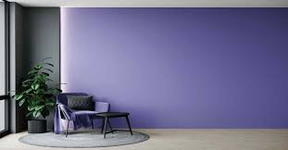
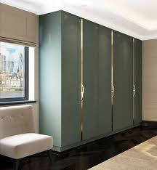
Wall Painting Colours (As per Your Choice)
Wardrobes in Bed Room

Slide 8
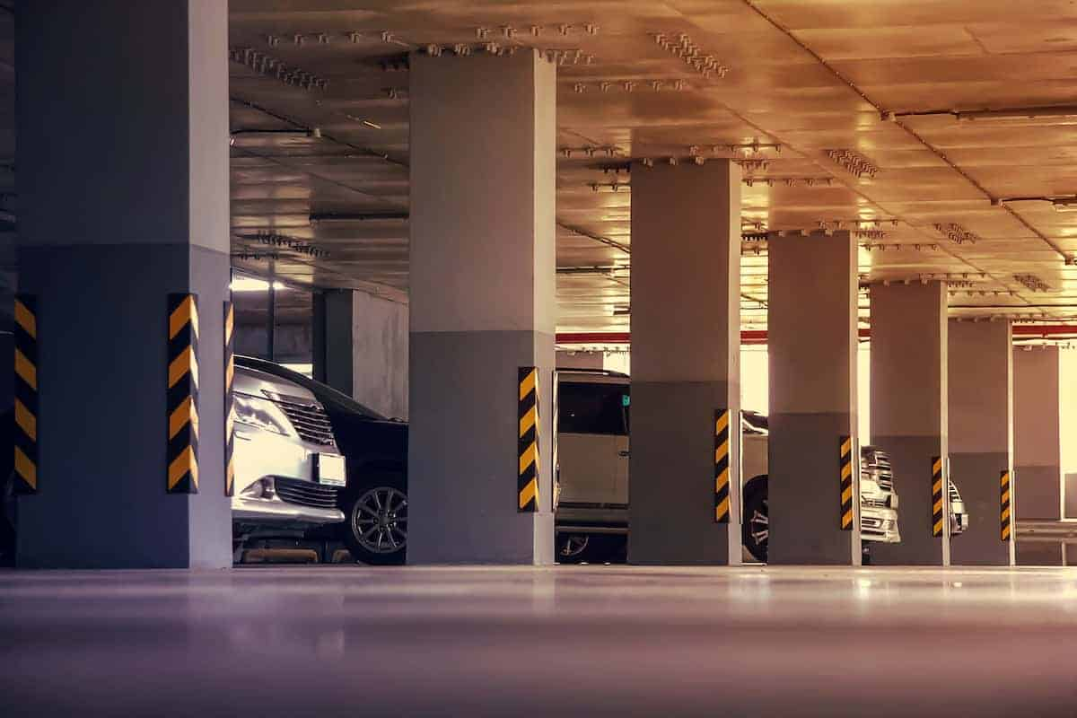
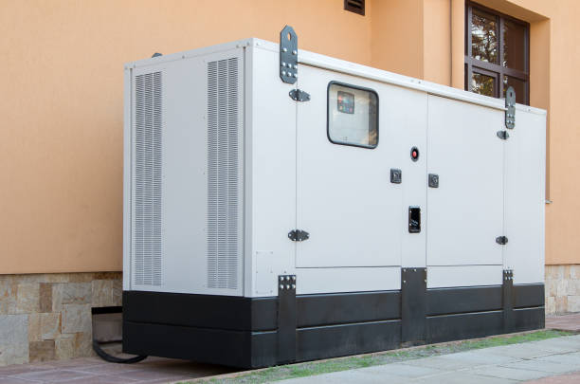

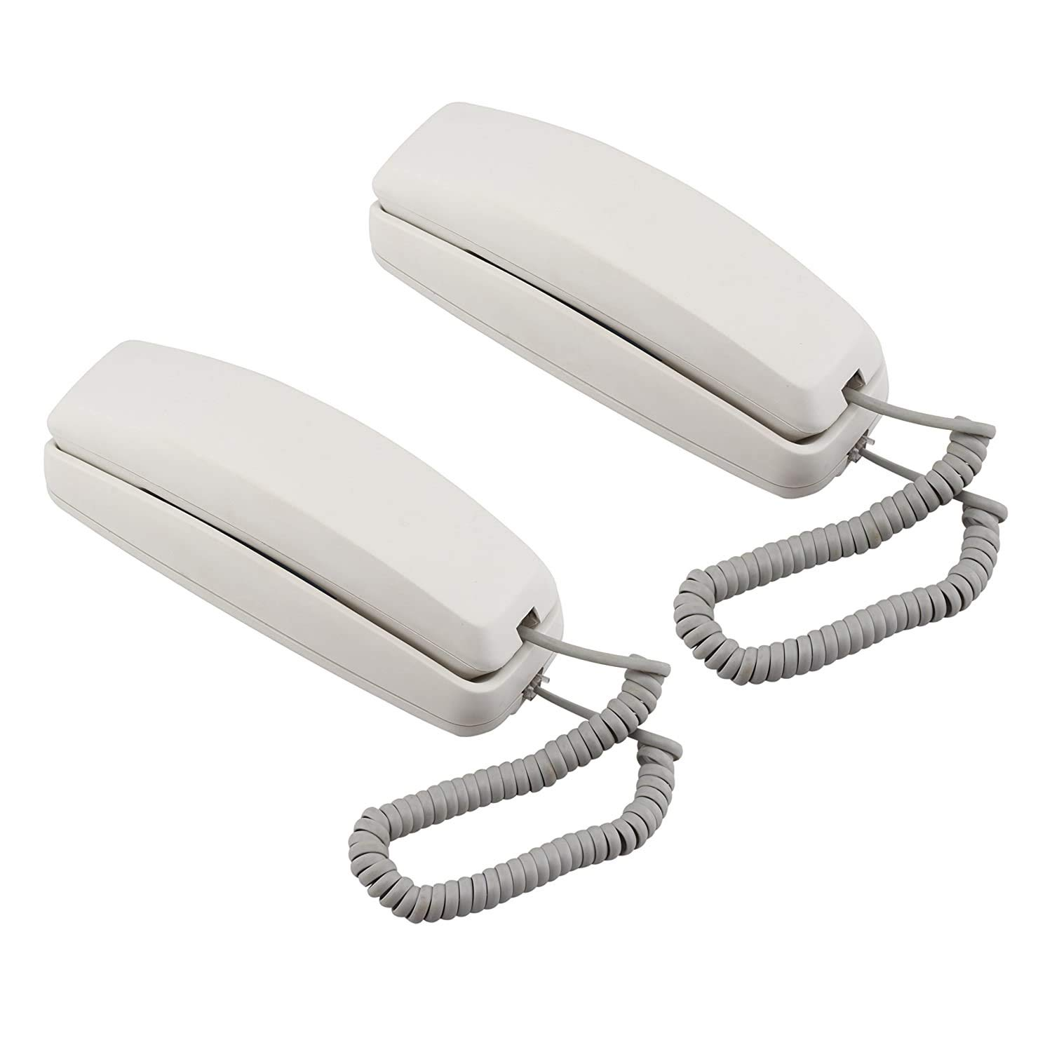
Special Attraction for Project
Lift
CCTv Surveillance
Covered Parking
Power Backup
Water pump
Wi-fi
Intercom

Slide 9
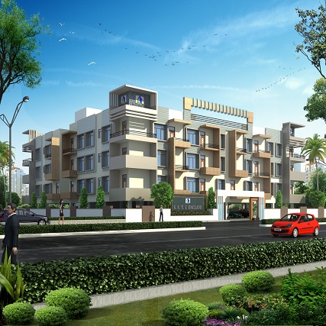
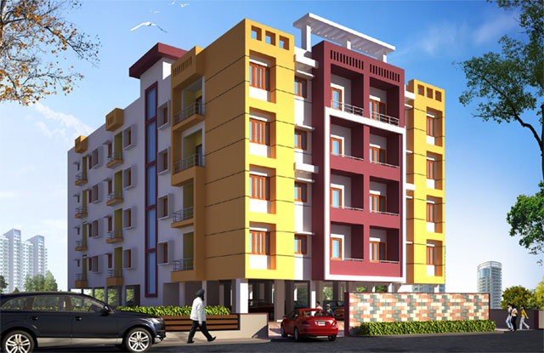
Our Successfully Completed & Handed Over Projects:-
Titanium Apartment
Abhishek Apartment

Slide 10
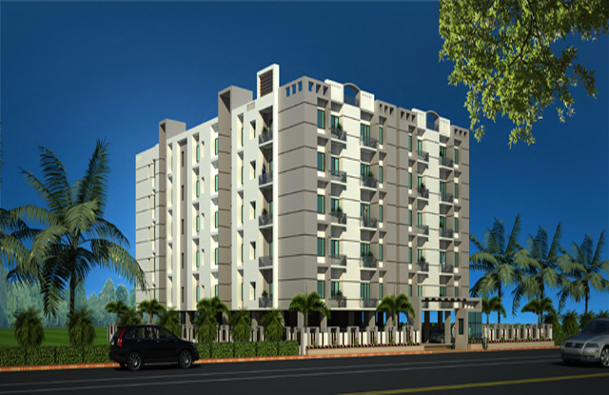
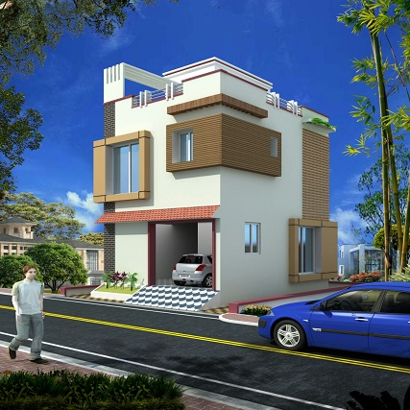
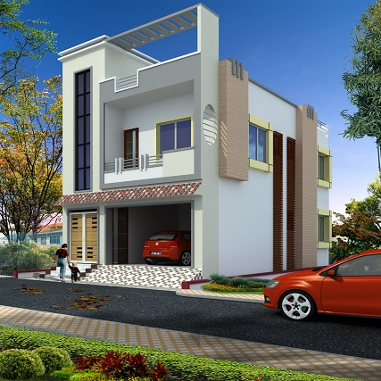
Our Successfully Completed & Handed Over Projects:-
R.P. Complex
Girija Society

Slide 11
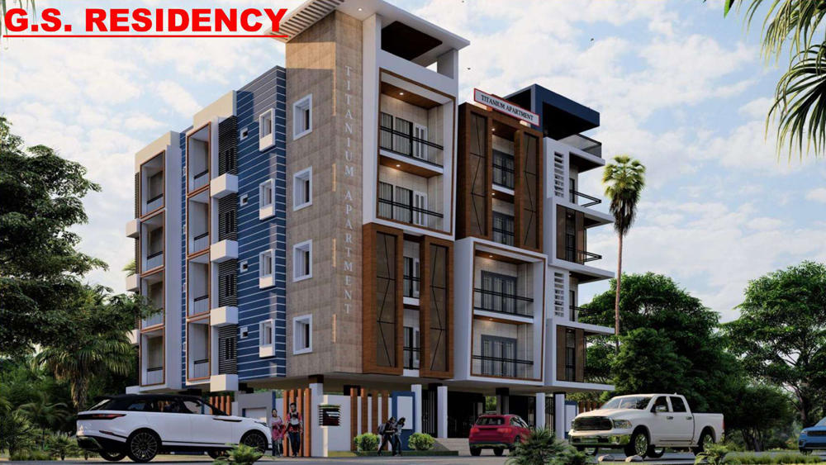
Our Other Ongoing Project
G S RESIDENCY
Chhata Chowk, Muzaffarpur
For More info feel free to visit us:
www.titaniumgroupindia.com

Slide 12

CONTACT DETAILS
CORPORATE OFFICE:
MAHARASTRA (MUMBAI) :- Bhiwandi, Maharastra, India, Pin – 421302
BRANCH OFFICE:
MUZAFFARPUR - Gobarsahi Chowk, Muzaffarpur, Bihar, India, Pin – 842001
MOTIHARI - Ambika Nagar, Motihari, East Champaran, Bihar, India, Pin – 845401
Website: www.titaniumgroupindia.com
Mobile: +91-706-115-4004 / 706-115-4001

Slide 13
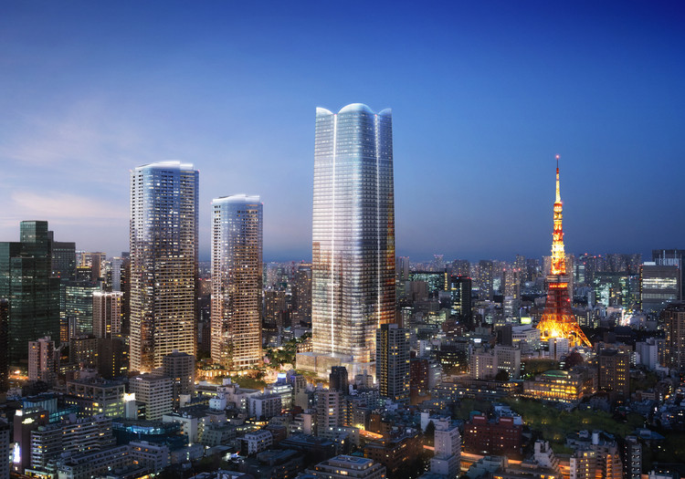
Thank You…

